Slide 1
Module 5 Week 2 – Neo4j

Slide 2
Neo4j Roadmap
Week 2
Week 1 Review
Continue With Cypher
Relationships
Query existing nodes and relationships
Using patterns for queries
Creating nodes and relationships
Deleting nodes
Aggregation
Procedures and Functions in Cypher
Importing , Transactions and Indexing
Graph Modeling in Neo4j
Lab 2

Slide 3
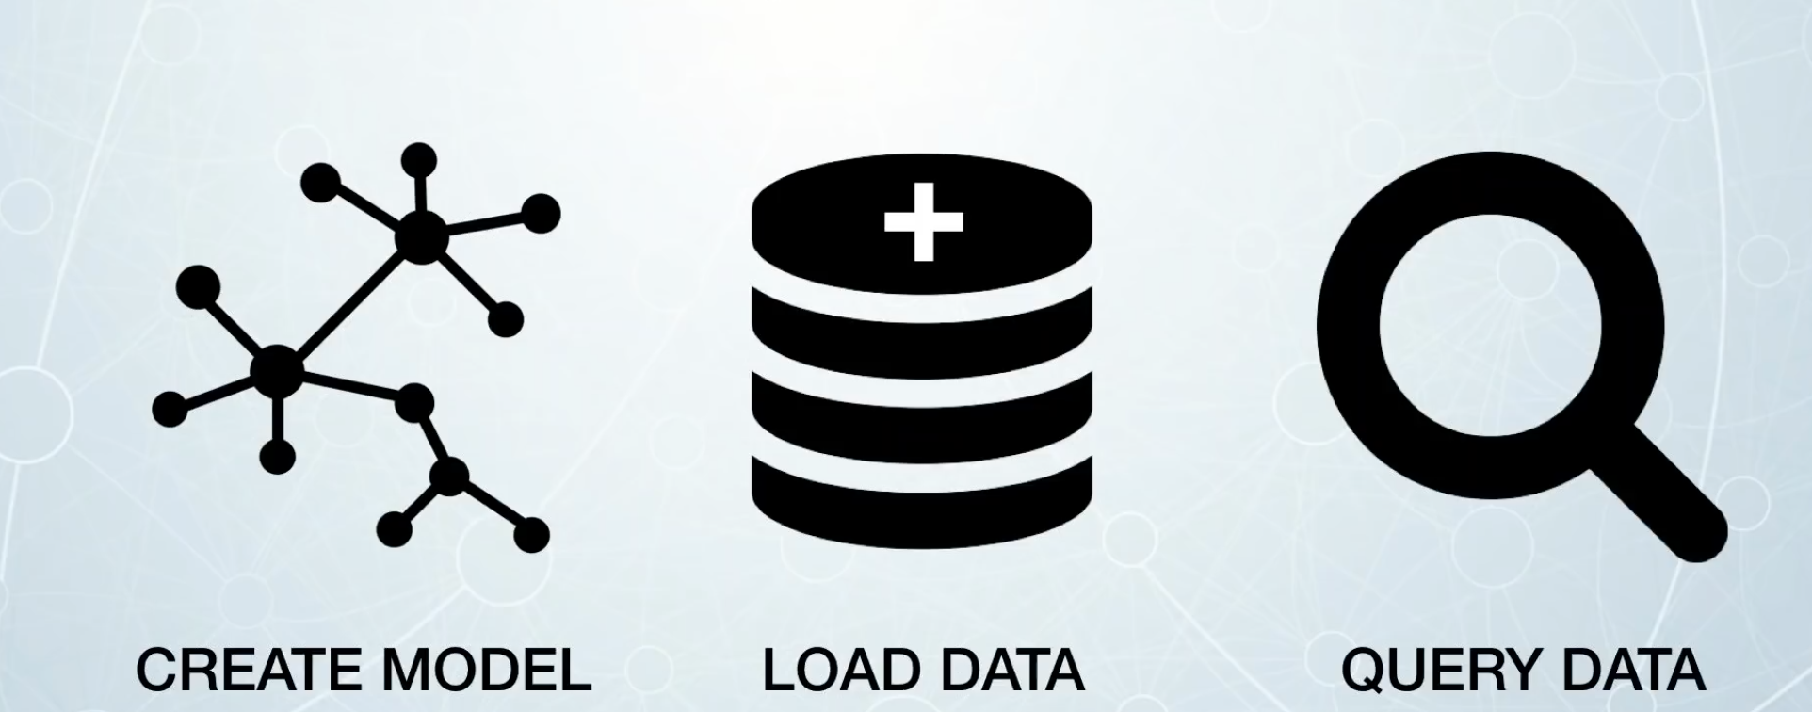
How Do You Use Neo4j?

Slide 4
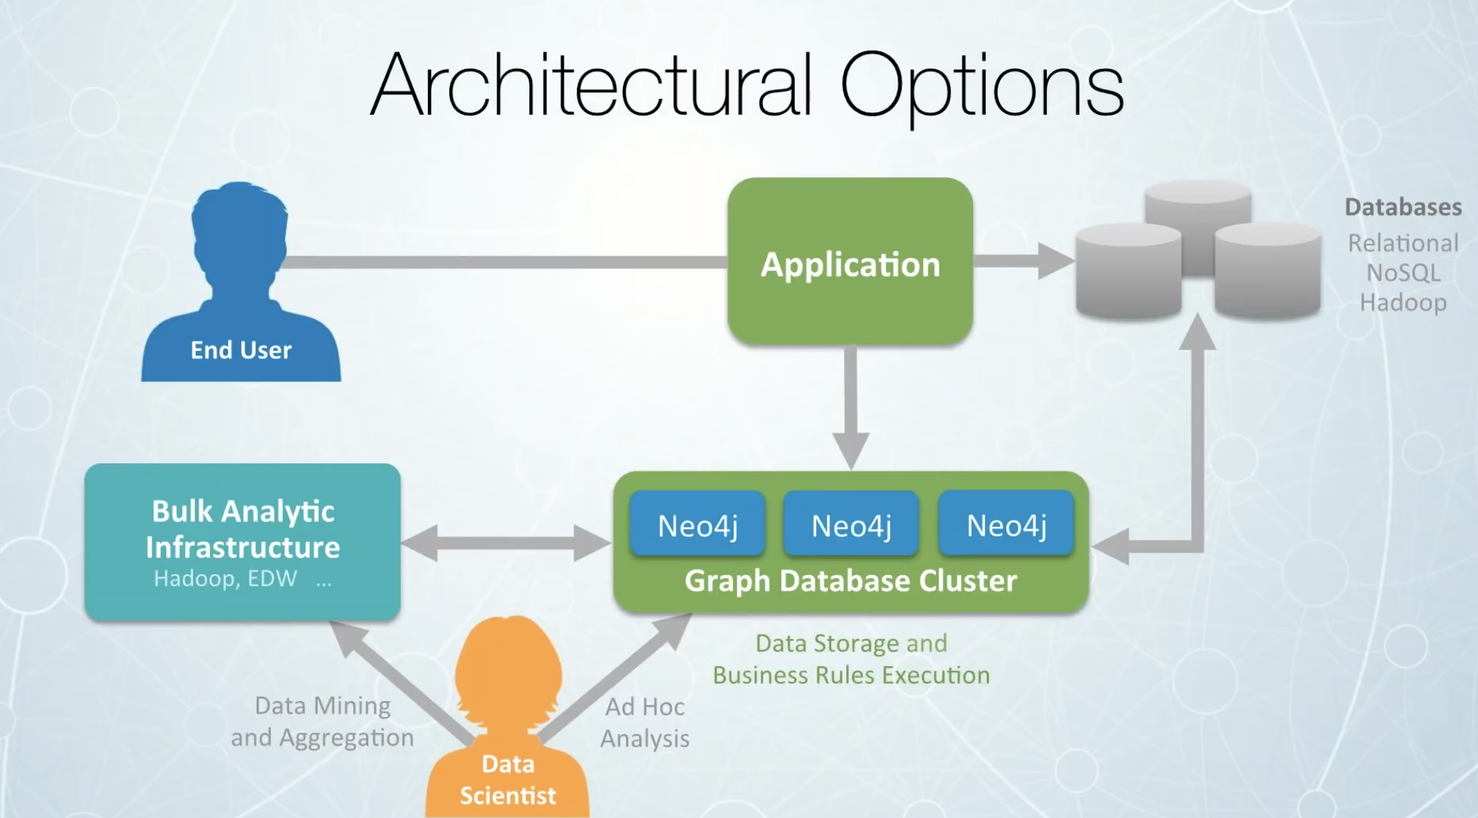
How Do You Use Neo4j?

Slide 5
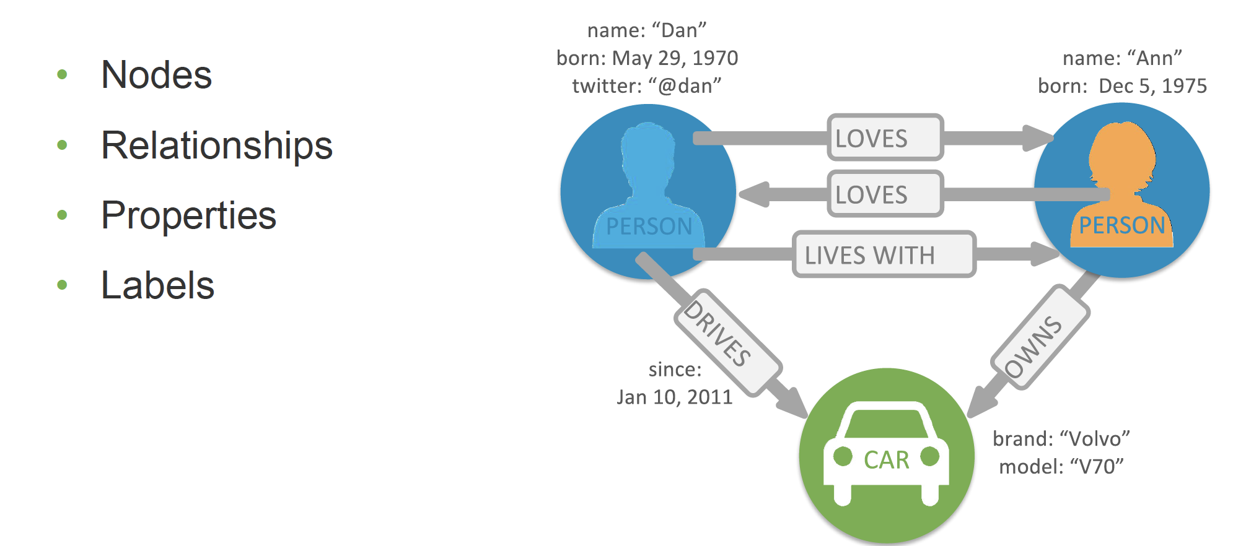
Week 1 Review

Slide 6
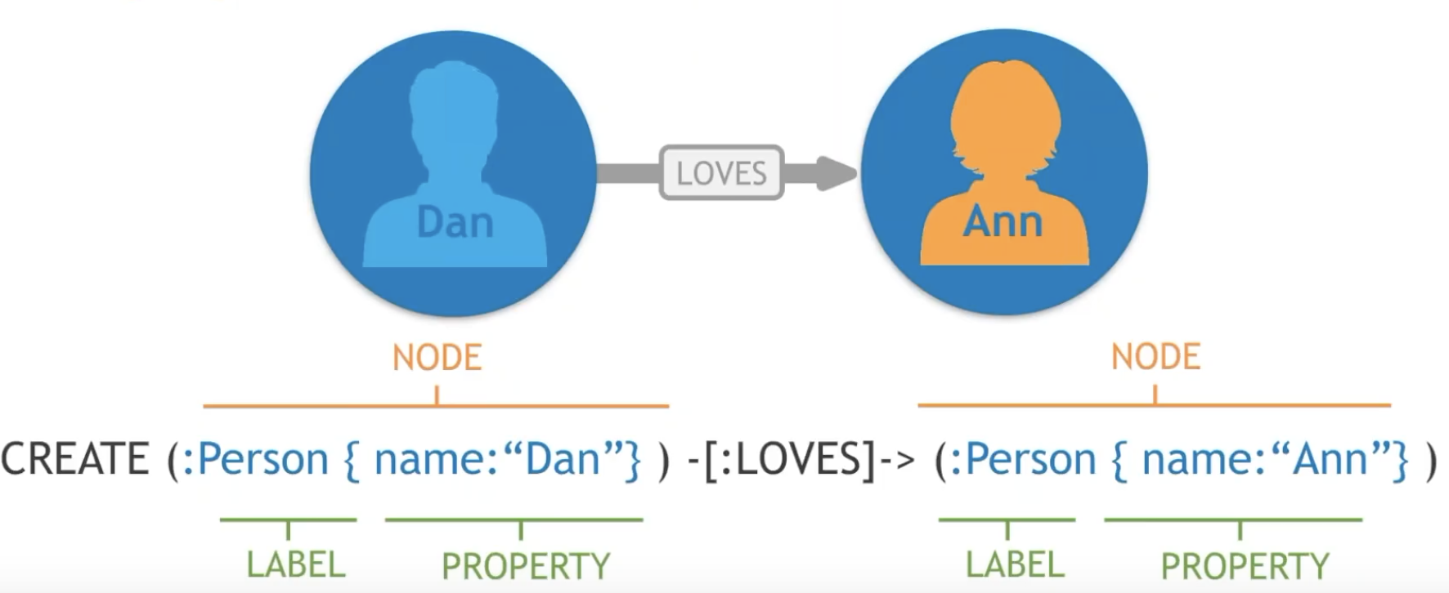
Week 1 Review

Slide 7
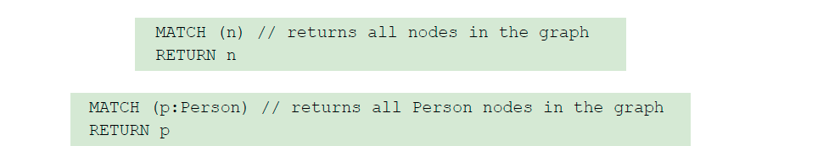
Week 1 Review
Composed of clauses
Simplest queries consist of MATCH clause followed by RETURN clause

Slide 8
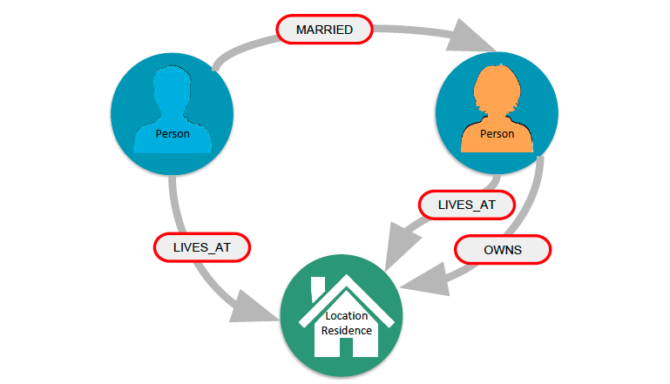
Neo4j Relationships

Slide 9
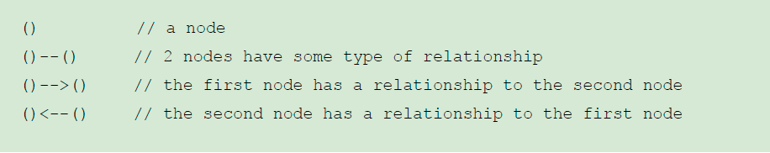
ASCII art for nodes and relationships

Slide 10
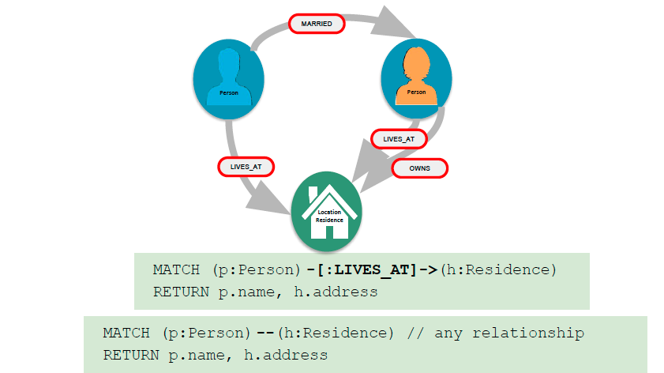
How to query using relationships

Slide 11
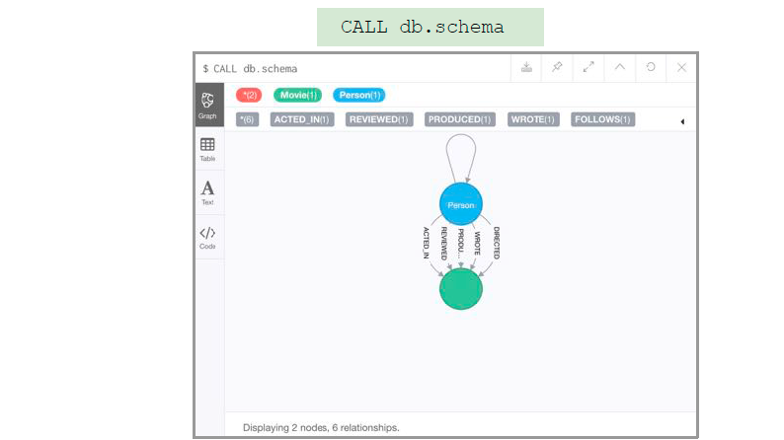
Examining relationships

Slide 12
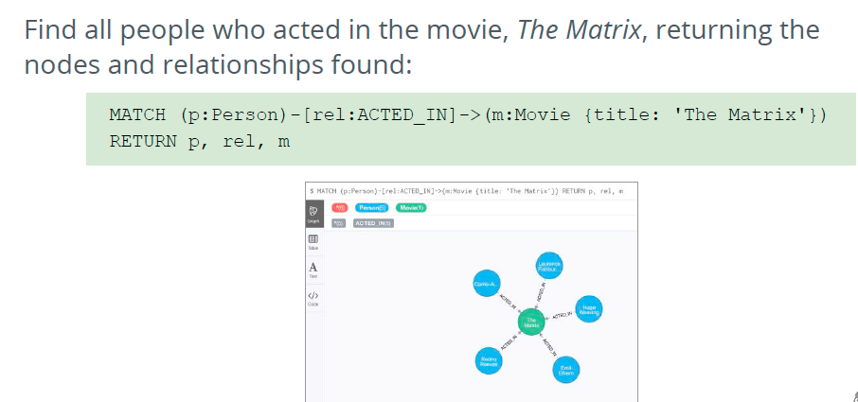
Using relationship in a query

Slide 13
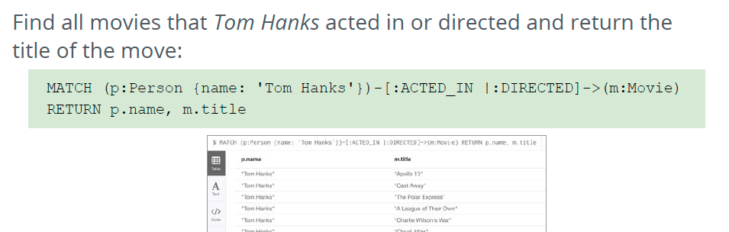
Query by multiple relationships

Slide 14
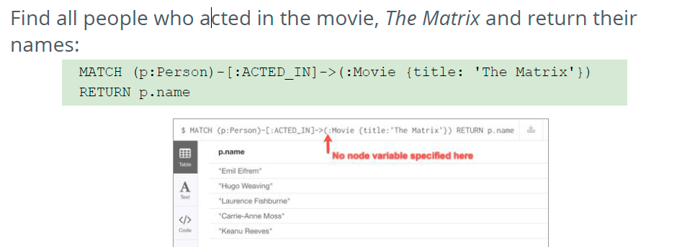
Use anonymous nodes in a query

Slide 15
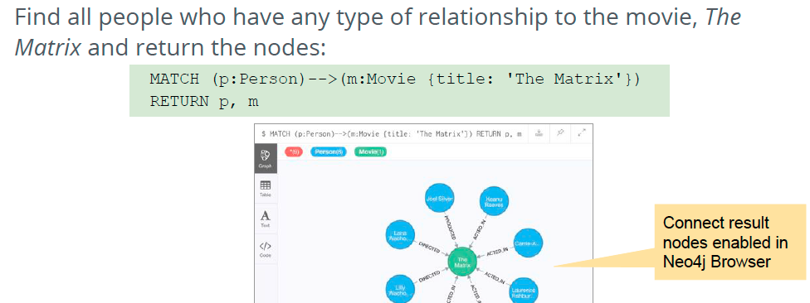
Use anonymous relationship for a query

Slide 16
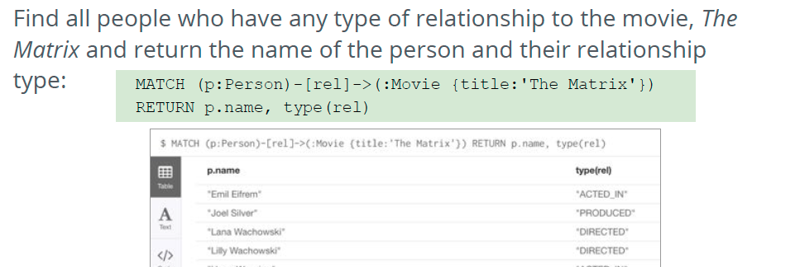
Retrieving relationship types

Slide 17
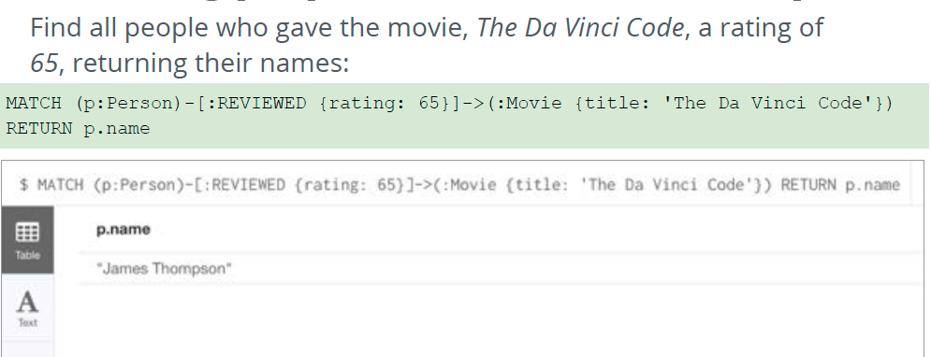
Retrieving properties for a relationship

Slide 18
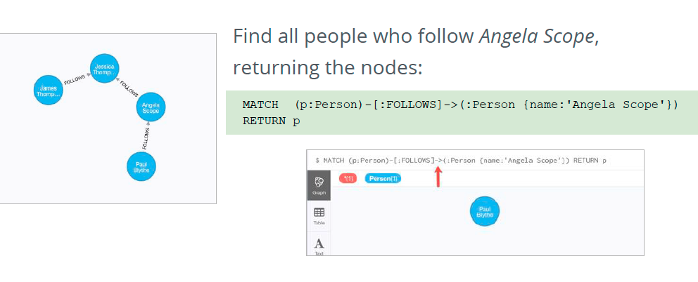
Using patterns for queries

Slide 19
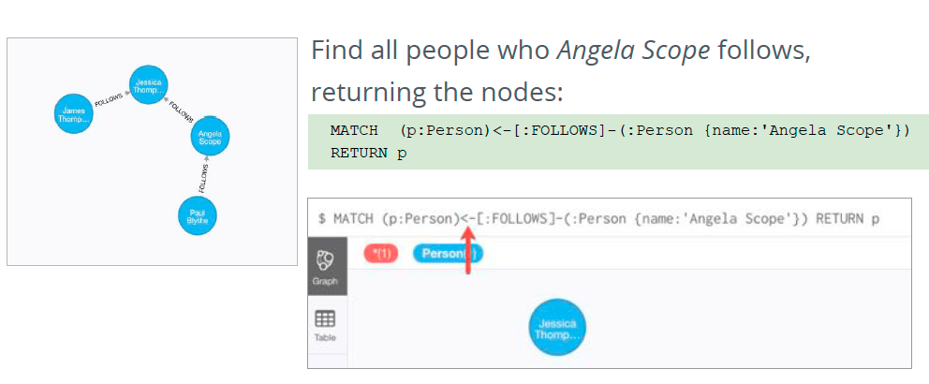
Using patterns for queries

Slide 20
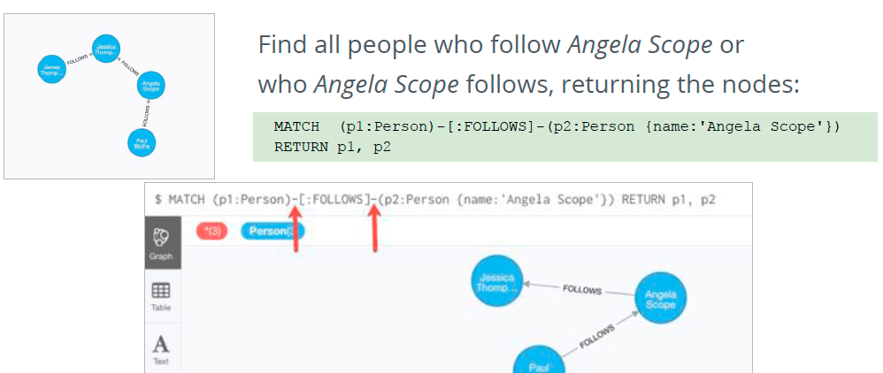
Querying by any direction of the relationship

Slide 21
Graph Traversal
Graph traversal – most common operation in any graph database
Find all possible paths between two nodes
Find the shortest path
Find shortest weighted path
Neo4j comes with built-in graph algorithms
Access by using REST API

Slide 22
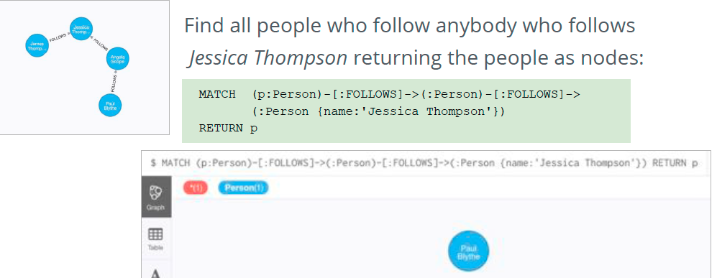
Traversing relationships

Slide 23
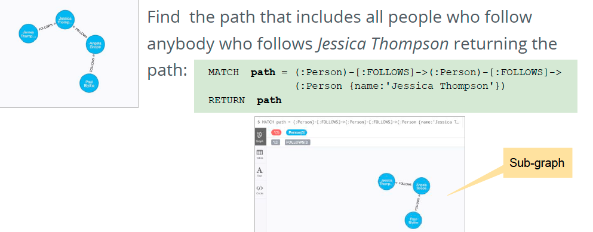
Traversing relationships

Slide 24
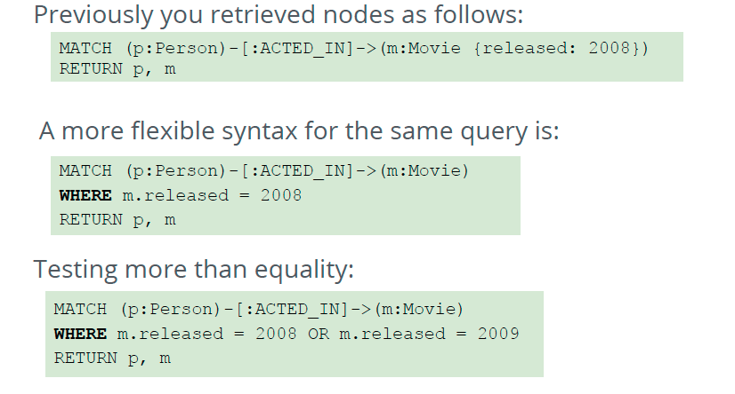
Filtering queries using WHERE

Slide 25
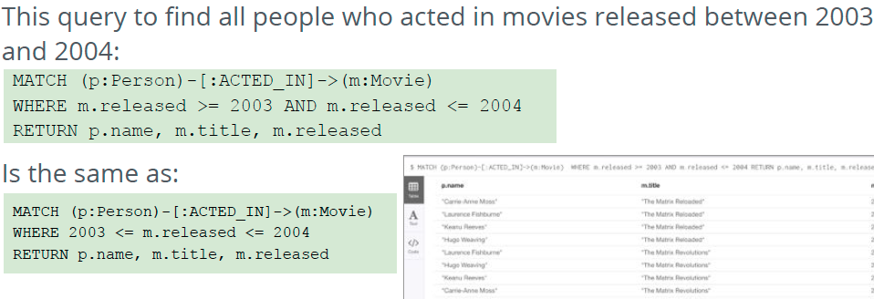
Specifying ranges in WHERE clause

Slide 26
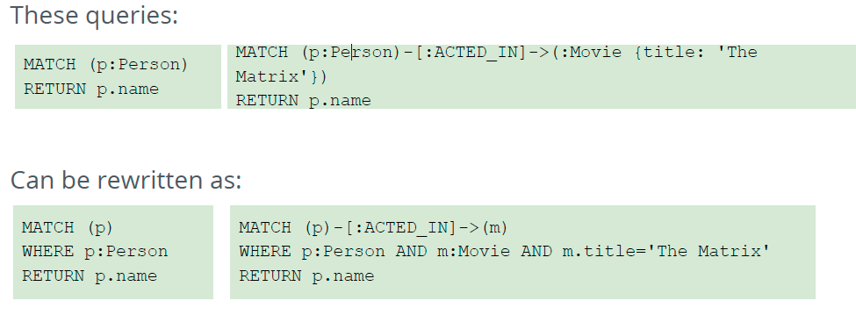
Testing Labels

Slide 27
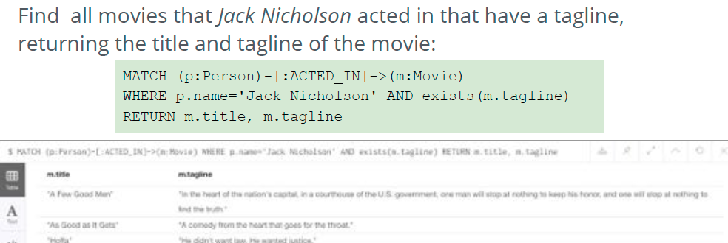
Testing the existence of property

Slide 28
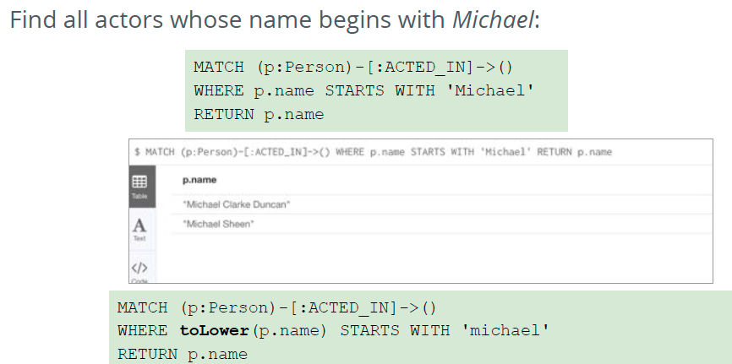
Testing Strings

Slide 29
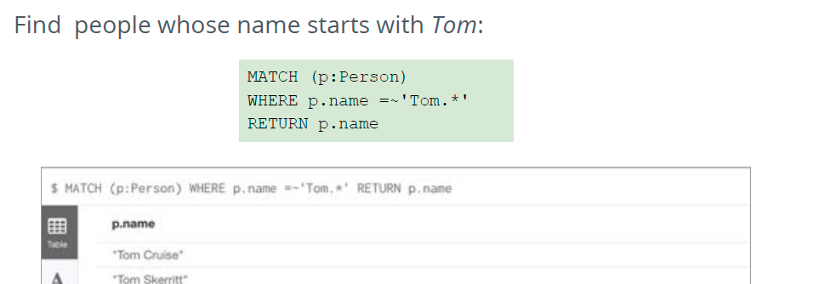
Testing with regular expressions

Slide 30
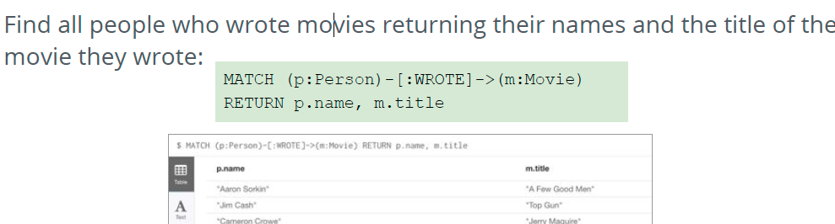
Testing with patterns
Notes:
:

Slide 31
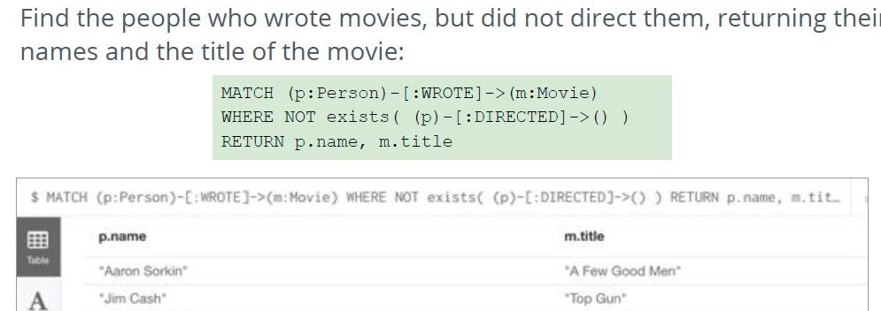
Testing with patterns

Slide 32
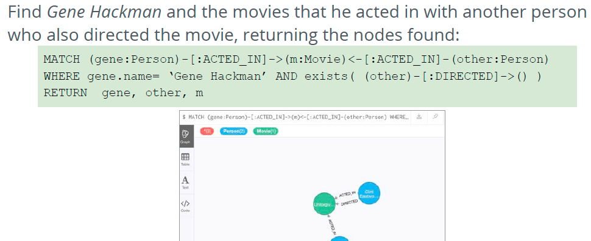
Testing with patterns

Slide 33
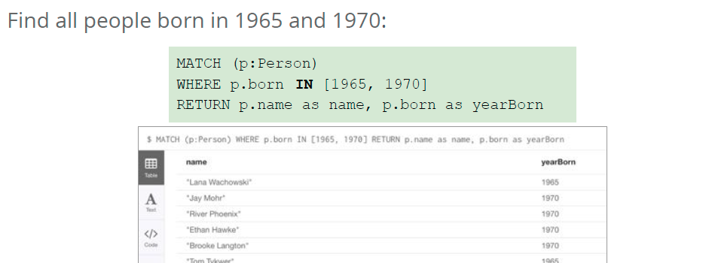
Testing with list values

Slide 34
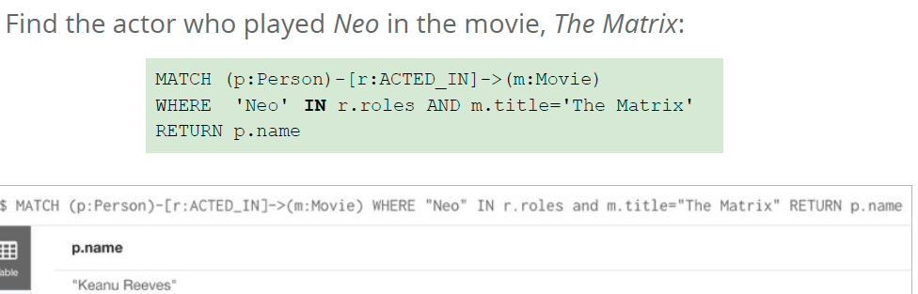
Testing with list values

Slide 35
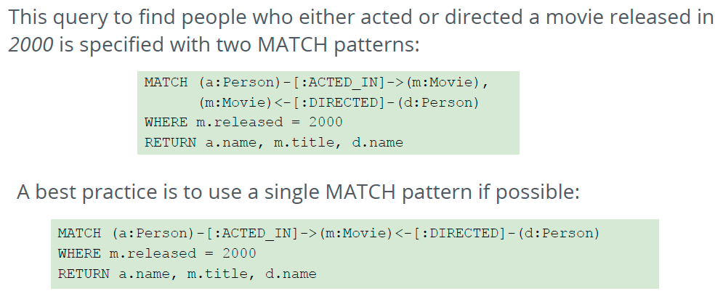
Specifying multiple MATCH patterns

Slide 36
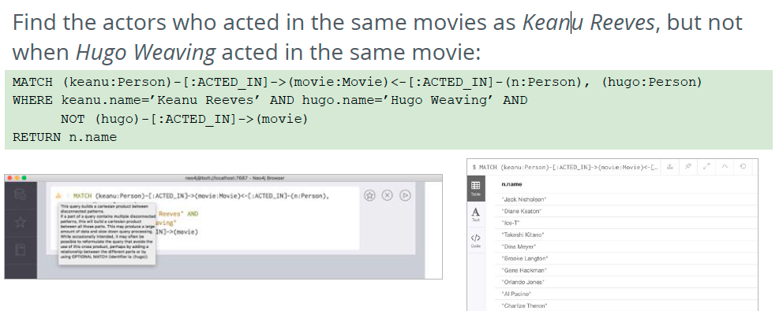
Using two MATCH patterns

Slide 37
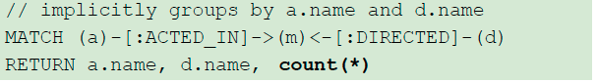
Cypher – Aggregation
Different from SQL – don’t need to specify a grouping key
As soon as you use the aggregation function, all non-aggregated result columns automatically become grouping keys
Implicit grouping based upon fields in RETURN clause

Slide 38
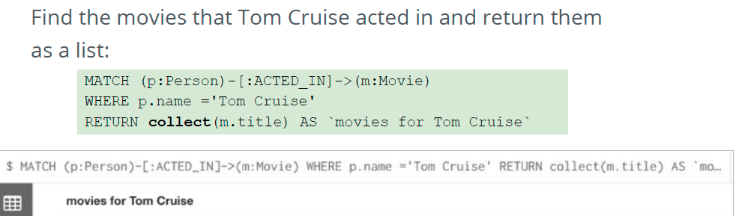
Collecting results

Slide 39
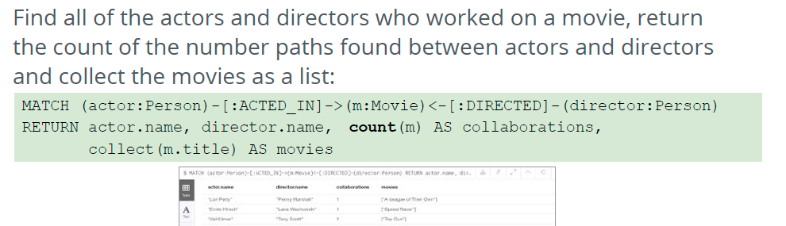
Counting results

Slide 40
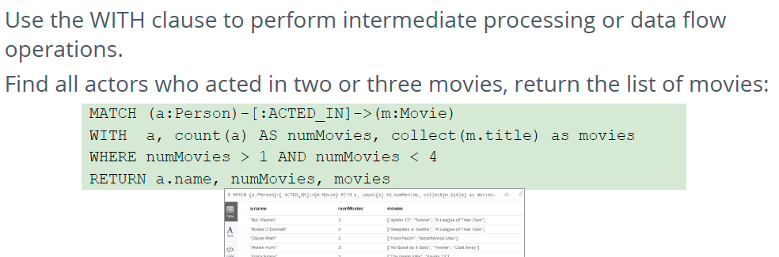
Additional processing with WITH

Slide 41
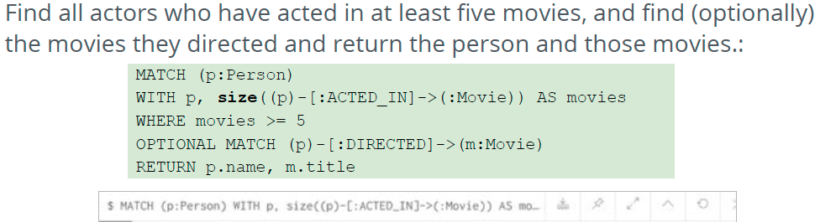
Additional processing with WITH

Slide 42
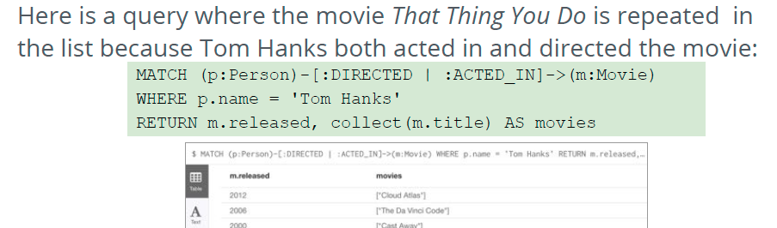
Eliminating Duplication

Slide 43
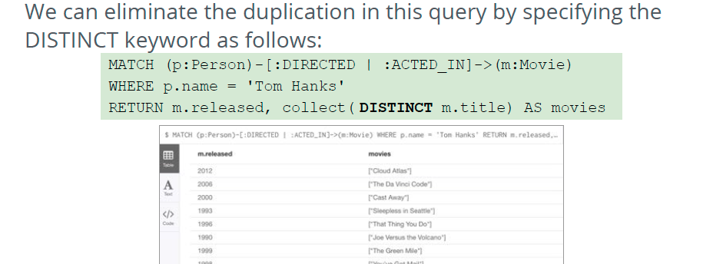
Eliminating Duplication

Slide 44
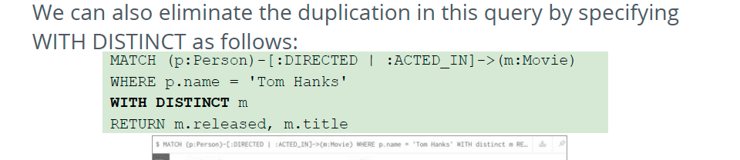
Eliminating Duplication

Slide 45
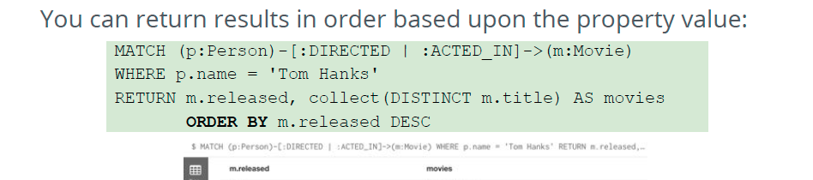
Ordering results

Slide 46
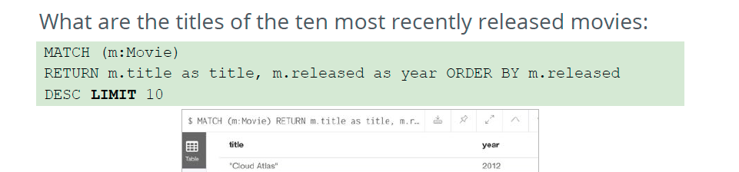
Limiting results

Slide 47
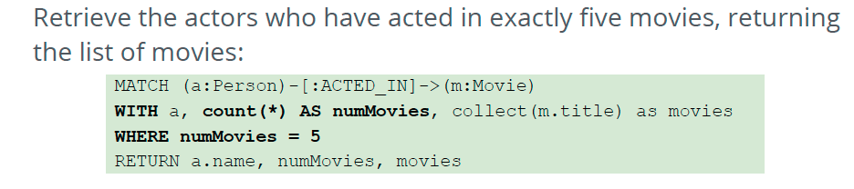
Controlling the number of results using WITH

Slide 48
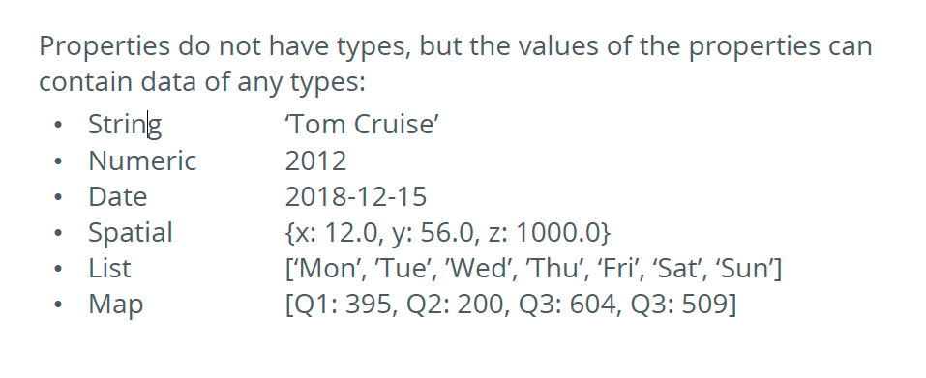
Working with Cypher data

Slide 49
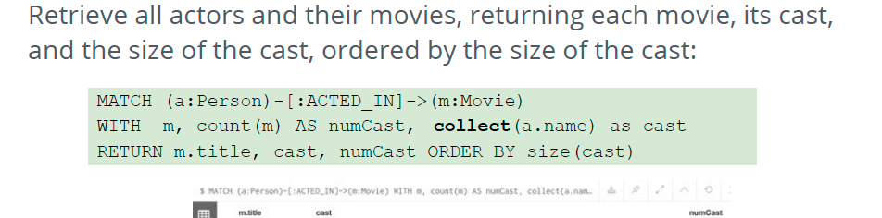
Lists

Slide 50
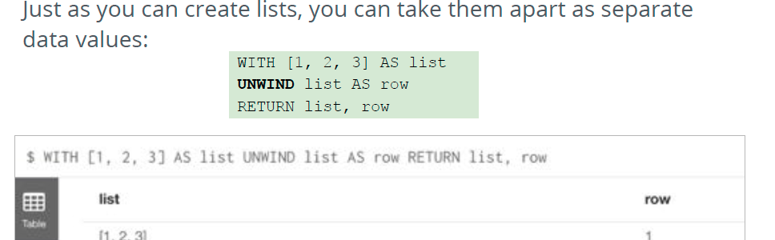
Unwinding Lists

Slide 51
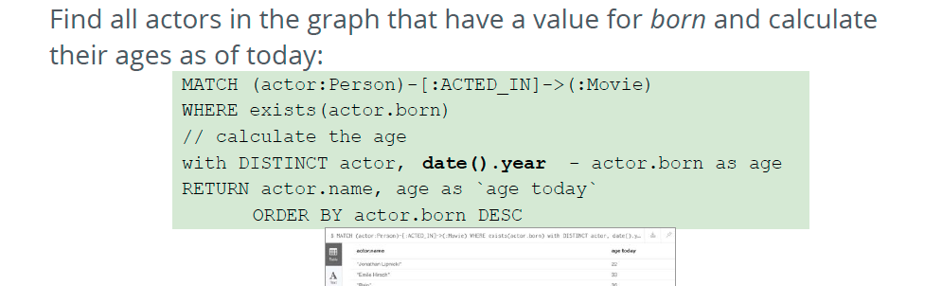
Dates

Slide 52
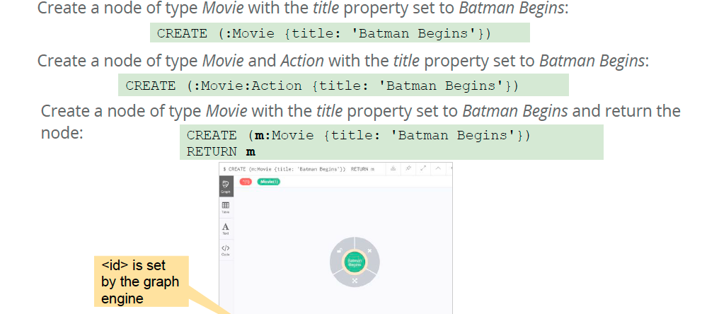
Creating a node

Slide 53
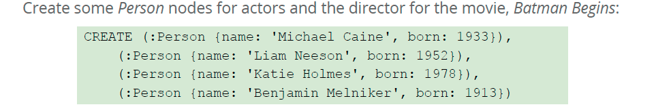
Creating multiple nodes

Slide 54

Adding a label to a node

Slide 55

Adding or updating properties for a node

Slide 56

Adding or updating properties for a node – JSON style

Slide 57

Creating a relationship

Slide 58

Creating multiple relationships

Slide 59

Adding properties to relationships

Slide 60

Removing properties to relationships

Slide 61

Deleting a relationship

Slide 62

After deleting this relationship

Slide 63

Deleting relationship and a node

Slide 64

Deleting relationship and a node

Slide 65
Procedures and Functions in Cypher
Run PageRank
Import data from web APIs or other database systems
Refactor our graph
Run periodic jobs
Define custom logic

Slide 66

Procedures and Functions in Cypher
User-defined procedures and functions are written in JVM language, deployed into the database and called from Cypher

Slide 67

Procedures and Functions in Cypher
Functions
New in Neo4j 3.1
Simple computations
Return a single value
Can be used in any expression or predicate

Slide 68

Procedures and Functions in Cypher
Procedures
Introduced in Neo4j 3.0
More complex operations
Generate stream of results
Generate, fetch and compute data
Results available later in Cypher query

Slide 69
Procedures and Functions in Cypher
Built-in Procedures
Inspect schema
Monitor management data
Native user and role management
Causal cluster overview and routing
Inspect or kill running queries

Slide 70

APOC Procedure Library

Slide 71
APOC Procedure Library
Graph algorithms
Metadata
Manual indexes and relationship indexes
Full text search
Integration with MongoDB, ElasticSearch, Cassandra, RDBMS
Loading XML and JSON from APIs and files
Data and time functions
String and text functions
Import & Export
Can create triggers

Slide 72
APOC Procedure library
How to install
Download JAR file from GitHub
Copy to Neo4j plugins directory
Restart Neo4j

Slide 73
Indexing and Labels
Neo4j doesn’t use indexes to speed up JOIN operations
Useful for finding starting points by value, textual prefix or range
Create label specific index

Slide 74
Importing Data into Neo4j
Importing CSV data with LOAD CSV
Importing from JSON source
Importing from a JDBS source
Importing from an XML source

Slide 75
Importing Data into Neo4j
CSV import is most common way to import data into a graph:
Load data from a URL (https(s) or file)
Process data as a stream of records
Create or update the graph with the data being loaded
Use transactions during the load
Transform and convert values from the load stream
Load up to 10M nodes and relationships

Slide 76

Importing data

Slide 77

Importing data

Slide 78
Transactions in Neo4j
Neo4j is a transactional database
Any query that updates the graph runs a transaction
Cypher will either create a new transaction or run inside existing
If no transaction exists – Cypher will create one and commit
Existing transaction – query will run inside it, nothing saved until it finishes

Slide 79

Graph Modeling in Neo4j

Slide 80
Graph Modeling in Neo4j
Identify nodes in the graph (entities)
What properties are important?
Identify unique IDs
Identify all of the connections (relationships)
Repeat the process
Based on the type of questions we want to ask of our data

Slide 81
Graph Modeling in Neo4j
Example Application
Knowledge management
People, companies, skills
Cross organizational
Find my professional social network
Exchange knowledge
Interest groups
Help
Staff projects

Slide 82

Graph Modeling in Neo4j

Slide 83
Graph Modeling in Neo4j
Questions To Ask of the Domain
Which people, who work for the same company as me, have similar skills to me?
Identify Entities
Person
Company
Skill

Slide 84
Graph Modeling in Neo4j
Identify relationships between entities
Which people, who work for the same company as me, have similar skills to me?
Relationships
Person WORKS_FOR Company
Person HAS_SKILL Skill

Slide 85

Graph Modeling in Neo4j

Slide 86

Graph Modeling in Neo4j

Slide 87

Graph Modeling in Neo4j

Slide 88

Graph Modeling in Neo4j

Slide 89
Modeling Guidelines
Identify relationships between entities
Which people, who work for the same company as me, have similar skills to me?
Relationships
Person WORKS_FOR Company
Person HAS_SKILL Skill

Slide 90
Neo4J LAB 2

Slide 91
Sources
“Introduction to Neo4j”
“NoSQL For Mere Mortals”
”Graph databases: New Opportunities for Connected Data”
”Neo4j Graph Modeling”

